Slide 1

Request Analyzer
Install Guide

Slide 2
Pre-requisites
Licenses :
Power Apps Premium (required to play the premium app embedded into the report)
Power BI (to publish & share the report)
Sharepoint (required to host the csv files)
Privileges :
Access to admin portal to download the API call consumption data (files can eventually be provided by an admin, direct access is not needed)
Full read access to the following CoE tables (AAD Users, makers, Audit Logs)
Capability to create a new PBI workspace (done at solution import)
Data :
Access to the csv files containing consumption data
CoE Starter Kit Installed with Audit logs collection enabled
HTTP with AD Connector allowed in the environment where the Request Analyzer is installed

Slide 3
Main Steps
Install the solution
Approve App Connections
Link PowerBI with the newly installed app
Check PowerBI Data Connection

Slide 4
Main Steps
Install the solution
Approve App Connections
Link PowerBI with the newly installed app
Check PowerBI Data Connection

Slide 5
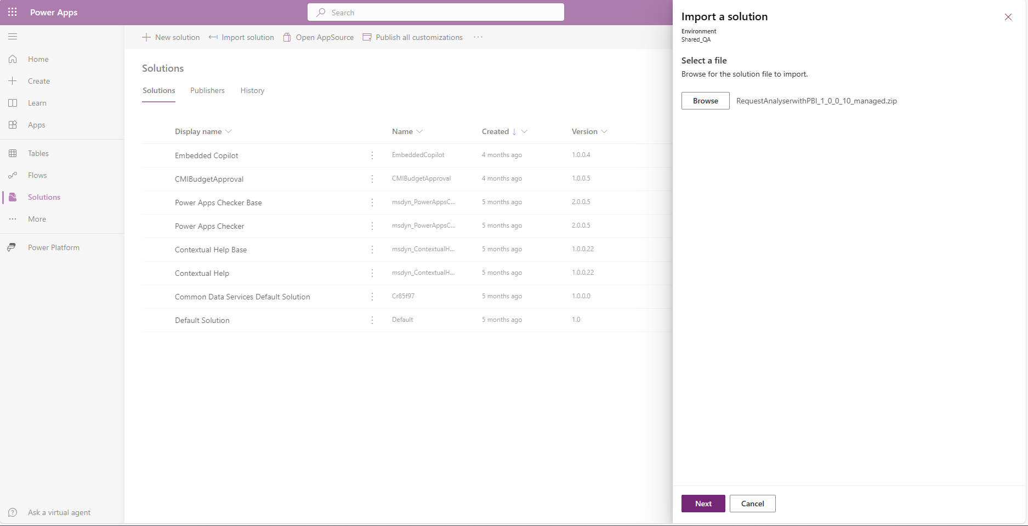
Import the solution
2
c
3
1
c
4
c

Slide 6
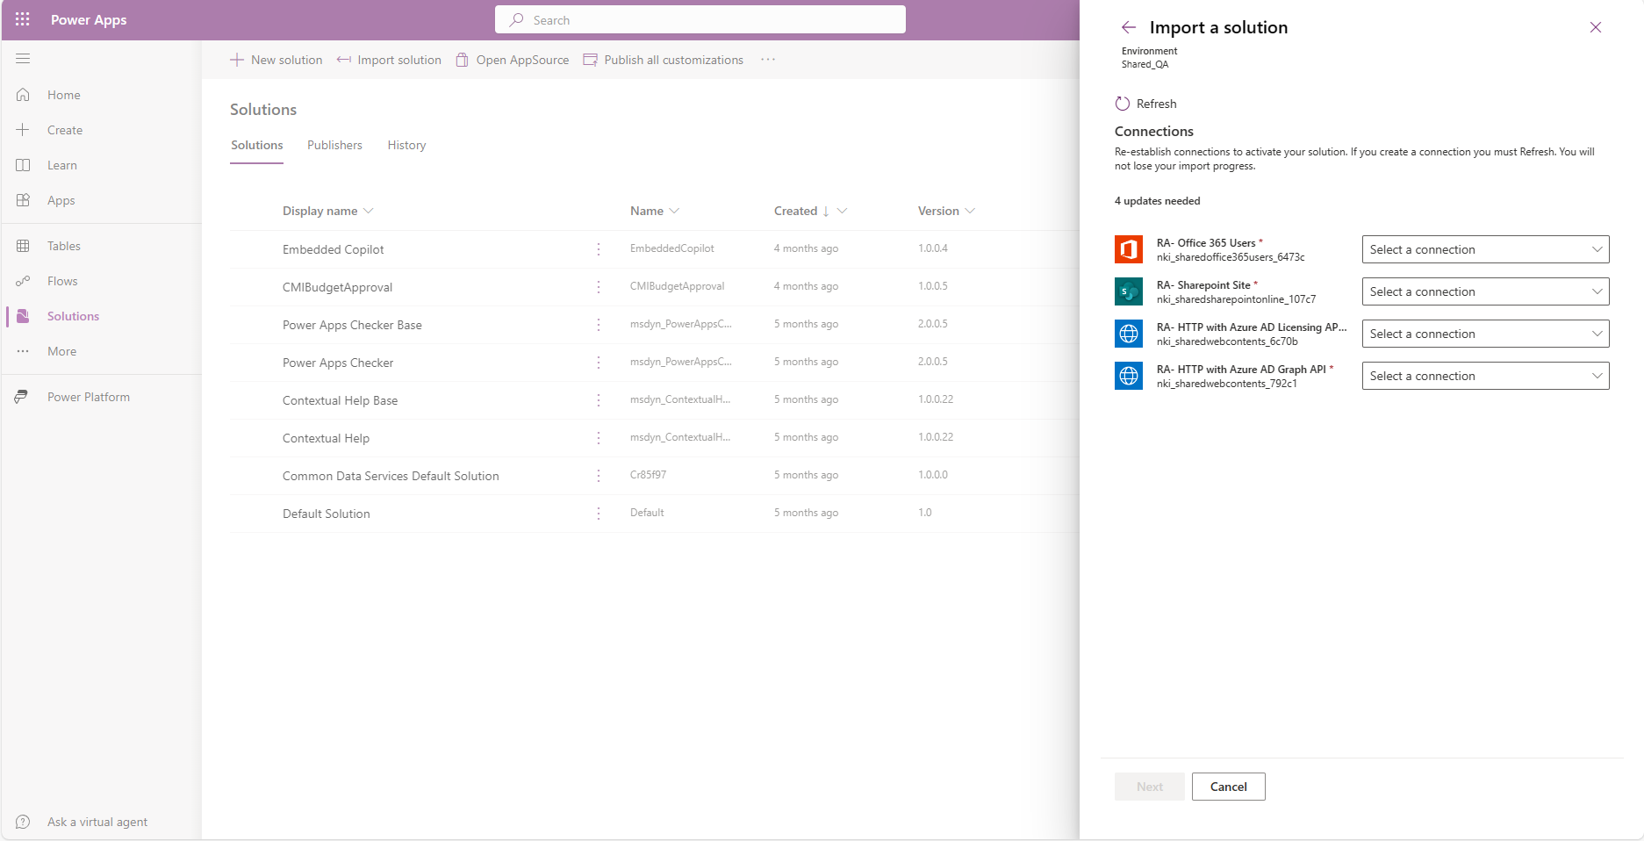
Create connections
1
c

Slide 7
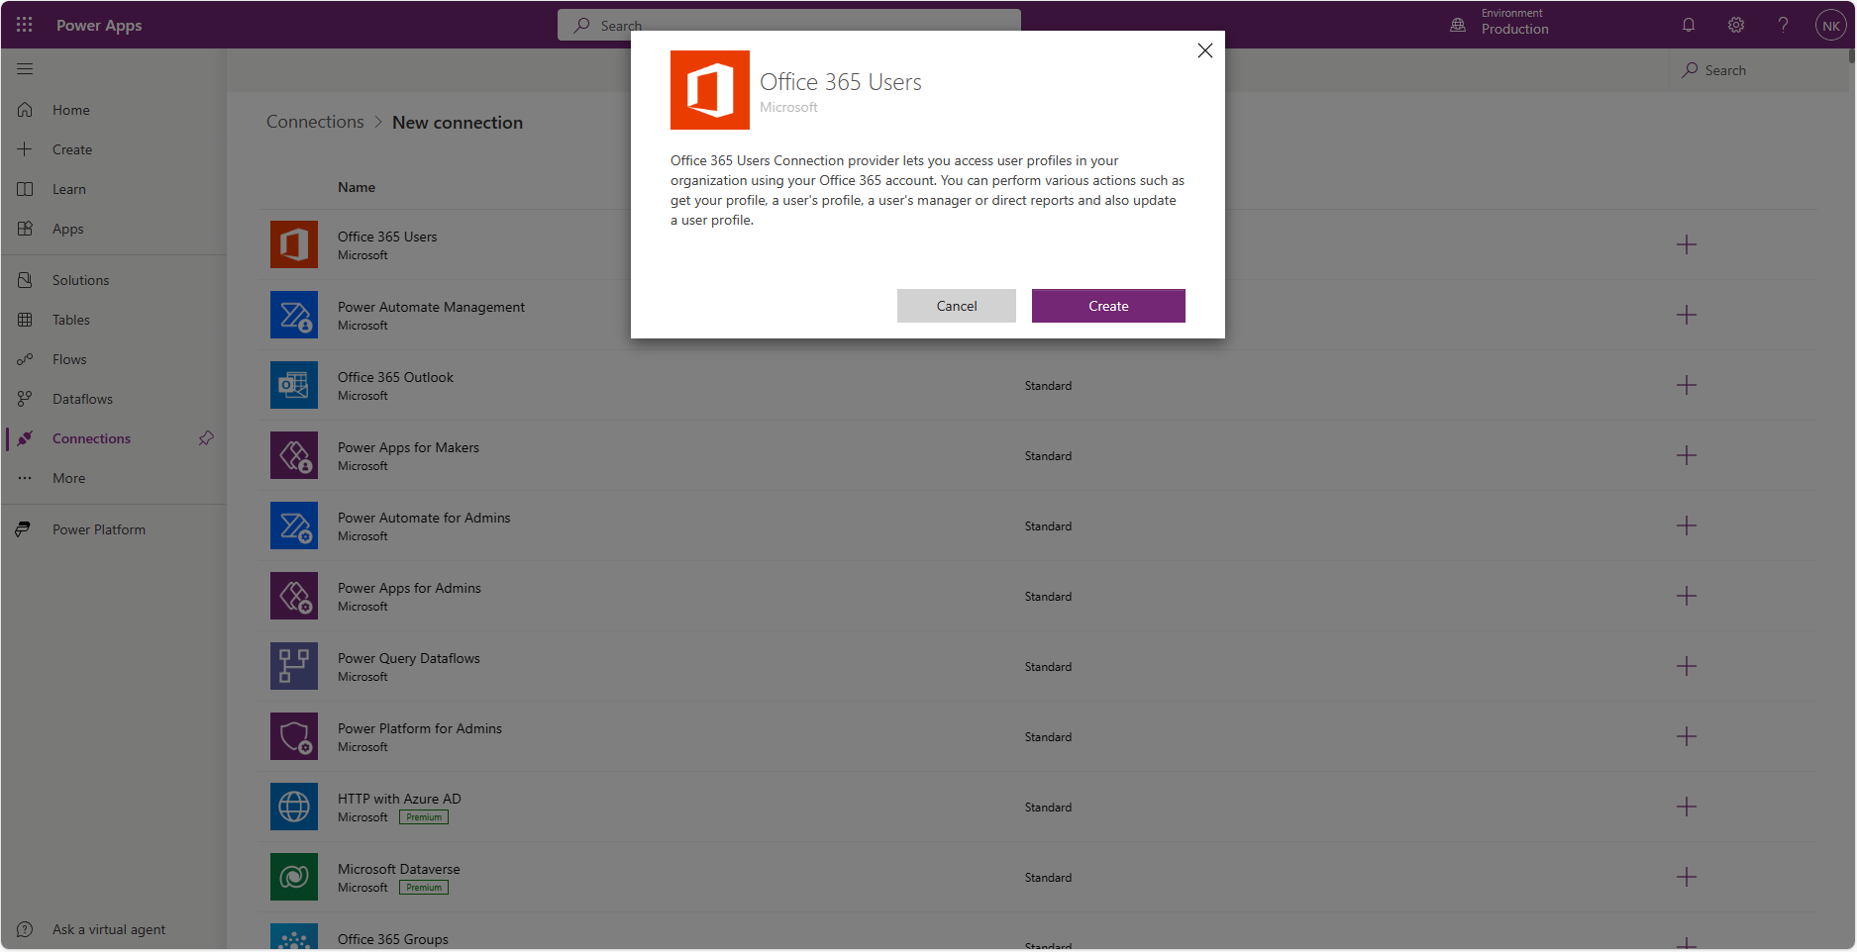
Create connections
1

Slide 8
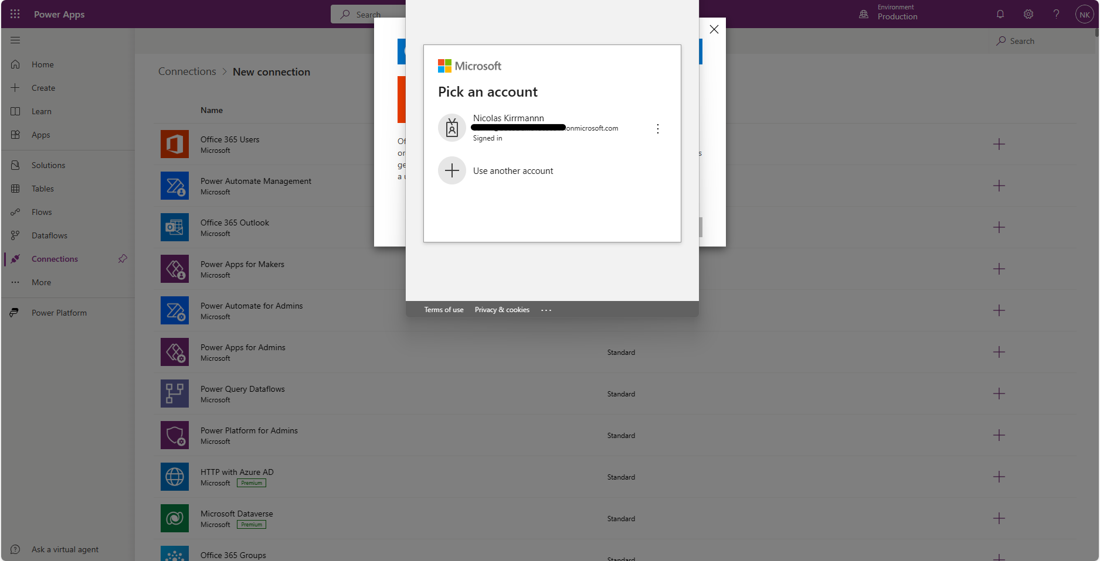
Create connections
1

Slide 9
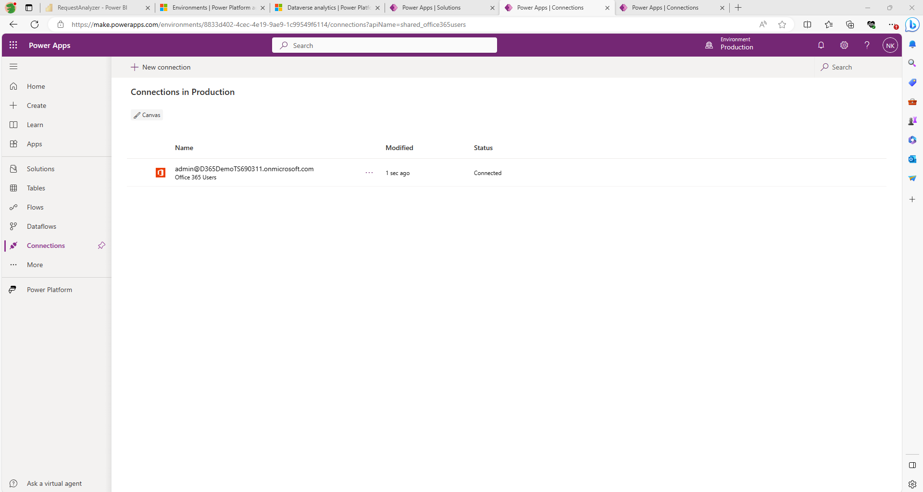
Create connections
1

Slide 10
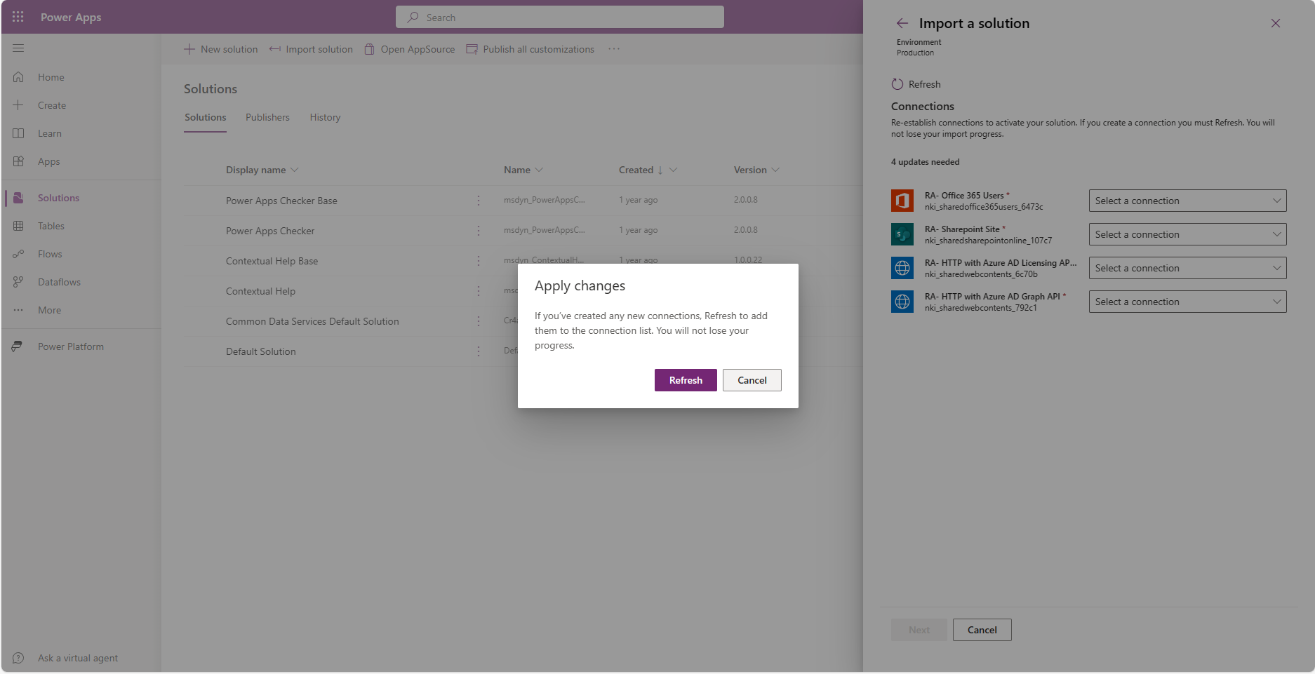
Create connections
2
Repeat same operations to create the Sharepoint connection
1

Slide 11
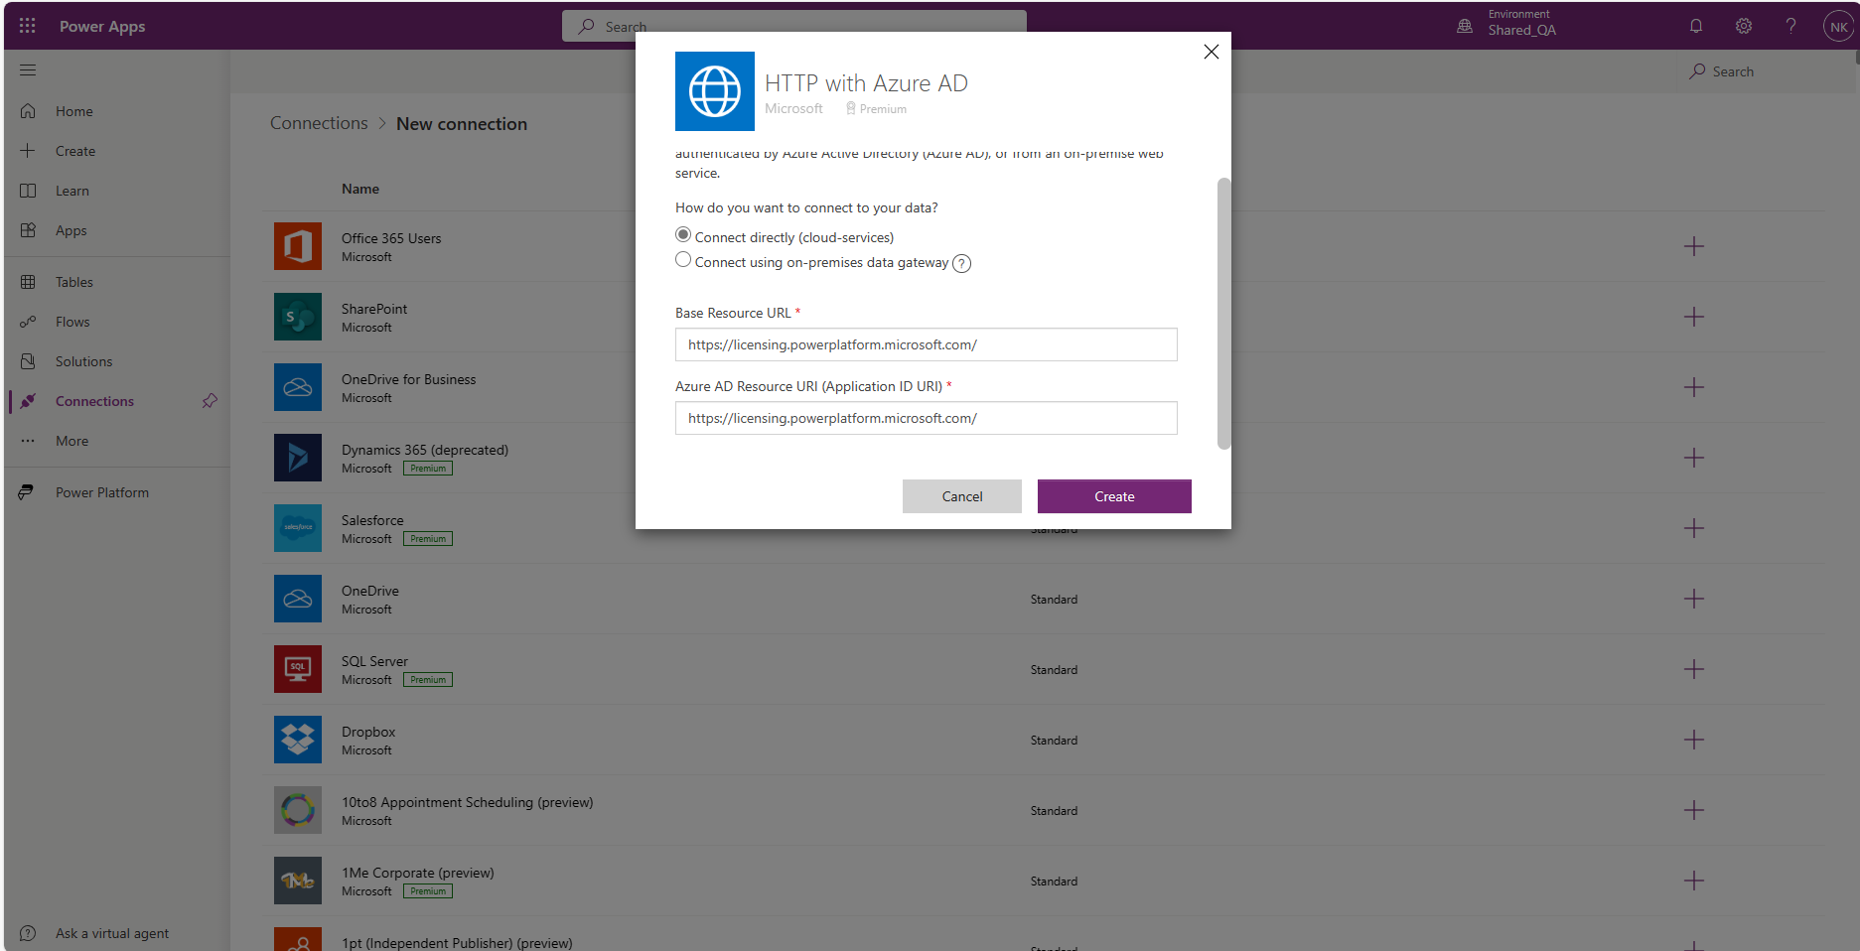
Create connections
The “HTTP with Azure AD” connections will require URL parameters
The first one asks for the licensing endpoint : https://licensing.powerplatform.microsoft.com

Slide 12
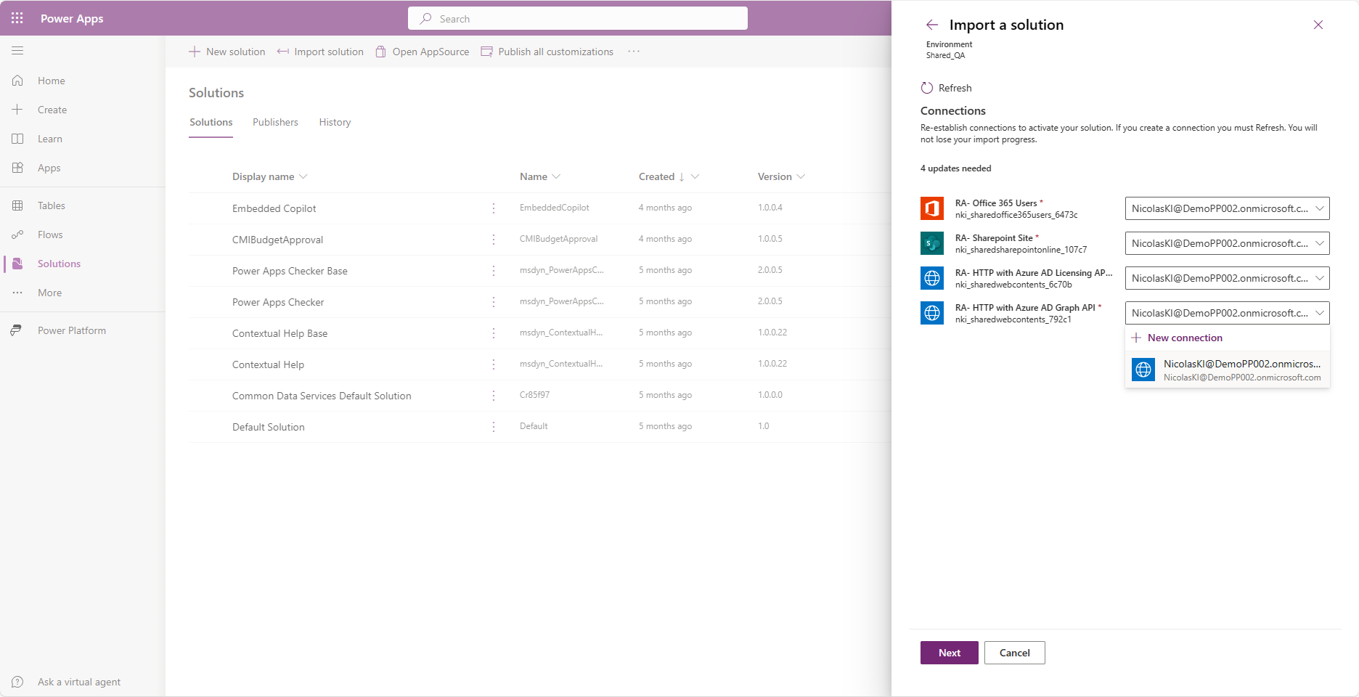
Create connections
The “HTTP with Azure AD” connections will require URL parameters
The second one asks for the graph endpoint.
Do NOT reuse the previous one but create another one

Slide 13
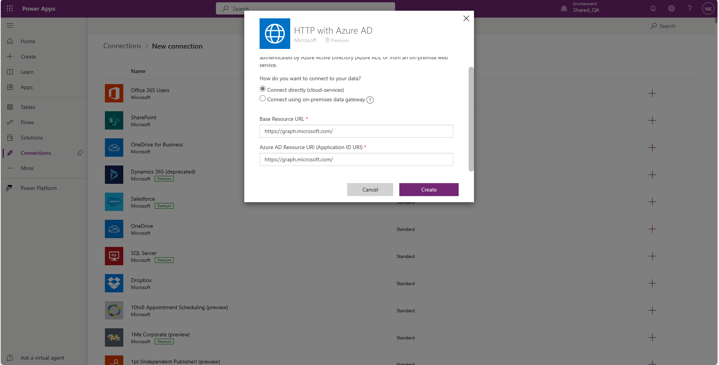
Create connections
The second “HTTP with Azure AD” connection require URL parameters
for the graph endpoint : https://graph.microsoft.com

Slide 14
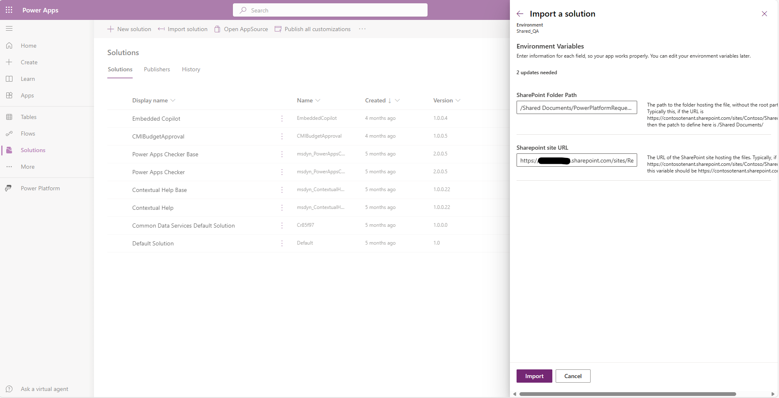
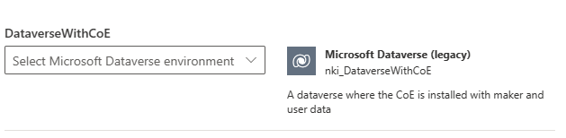
Create connections
Follow instructions to provide the precise SharePoint location to host API consumption data
1
Then define the environment where the CoE Starter Kit is running
2

Slide 15
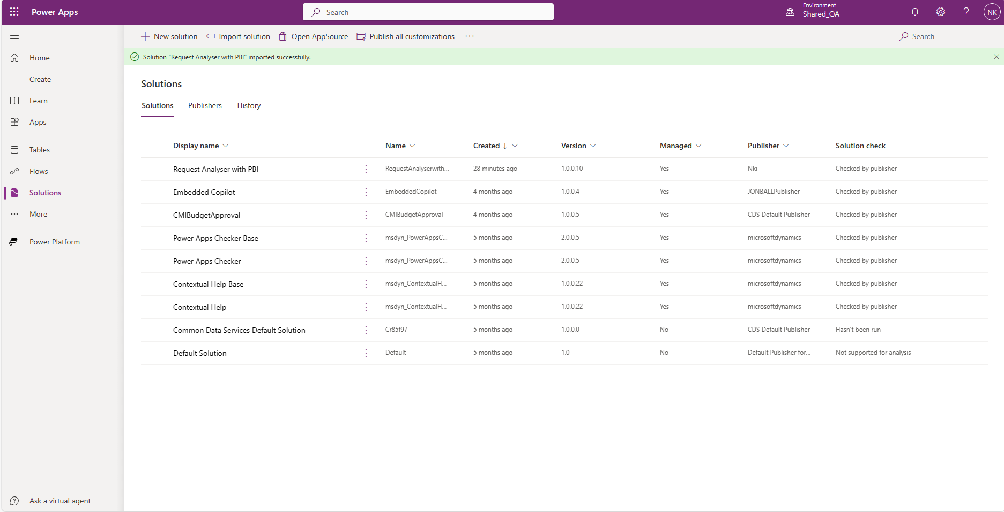
Create connections
The solution is imported

Slide 16
Main Steps
Install the solution
Approve App Connections
Link PowerBI with the newly installed app
Check PowerBI Data Connection

Slide 17
Create connections
Once the solution is imported, open it

Slide 18
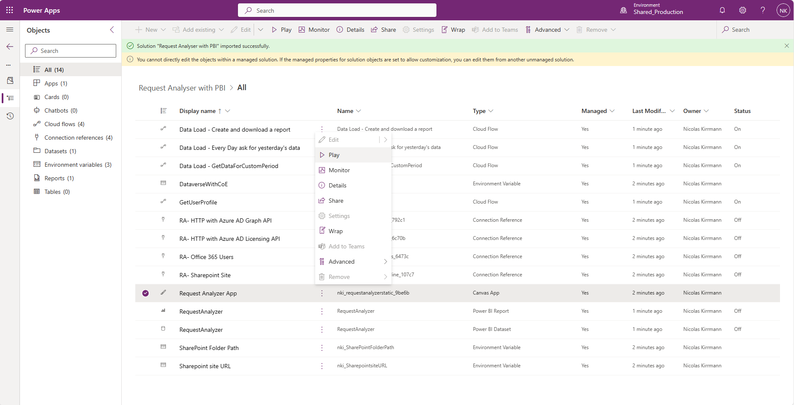
Create connections
Play the app

Slide 19
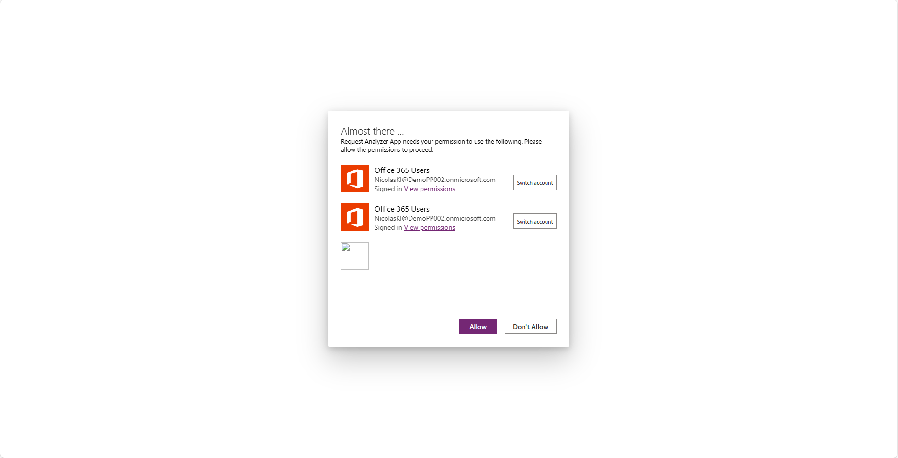
Create connections
Approve connections

Slide 20
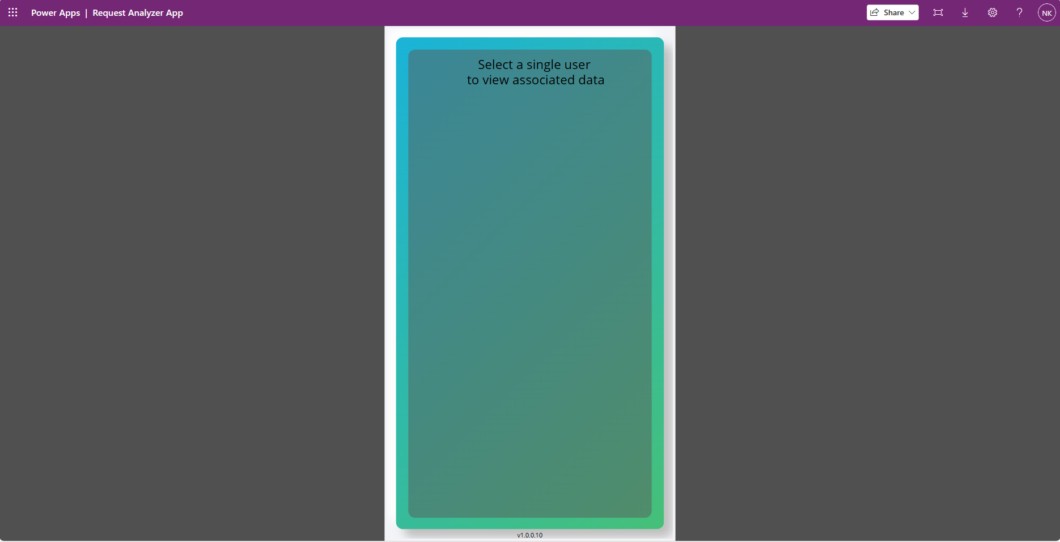
Create connections
Now the app is working

Slide 21
Main Steps
Install the solution
Approve App Connections
Link PowerBI with the newly installed app
Check PowerBI Data Connection

Slide 22
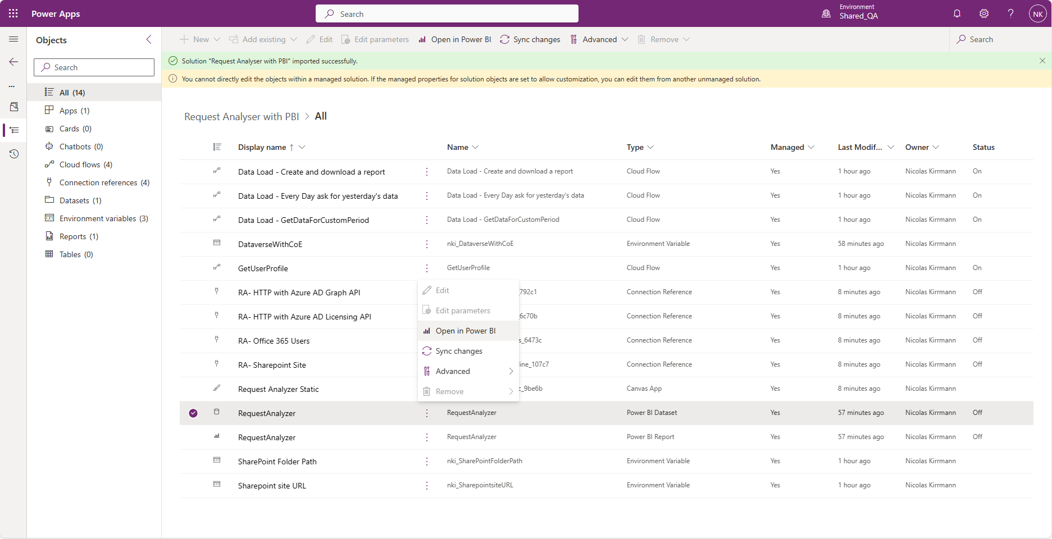
Create connections
Open the PowerBI dataset

Slide 23
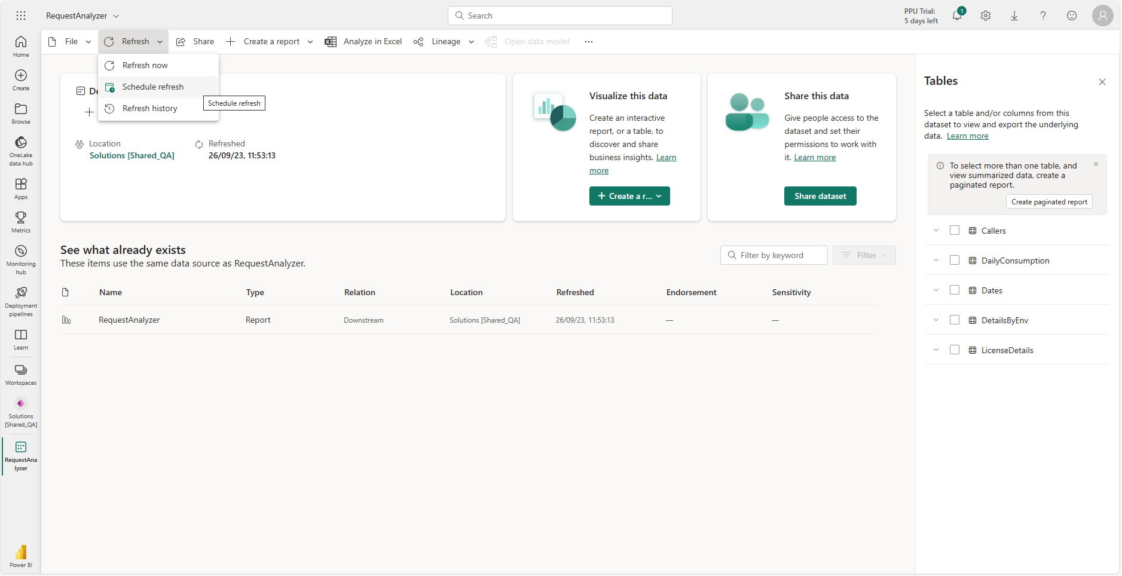
Create connections
Refresh the data, and check the refresh date is updated once the refresh is complete

Slide 24
Main Steps
Install the solution
Approve App Connections
Link PowerBI with the newly installed app
Check PowerBI Data Connection

Slide 25
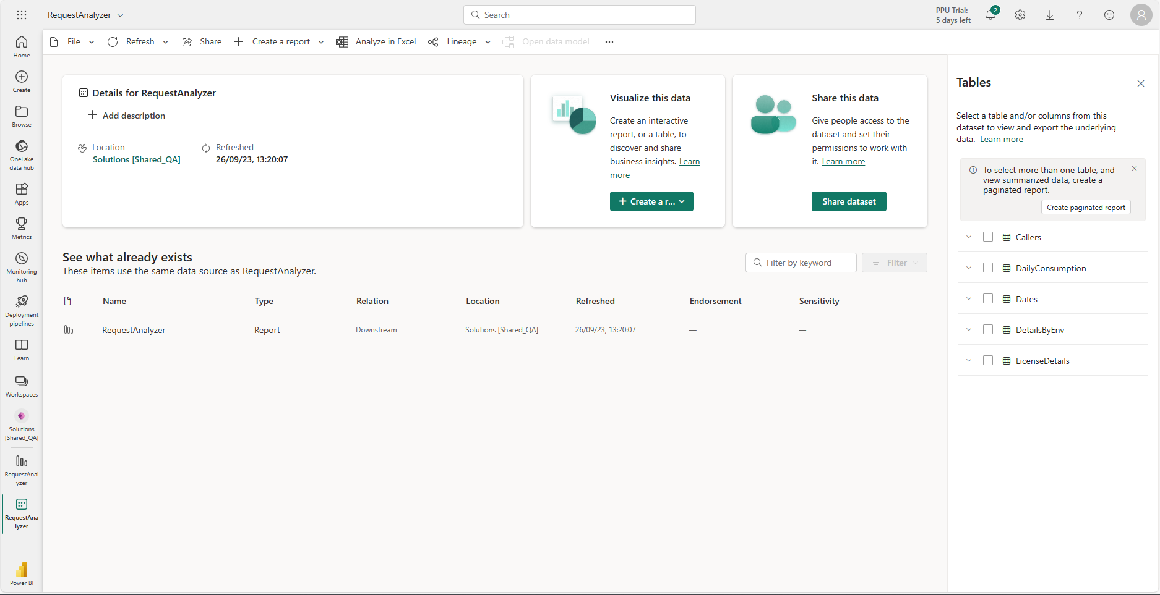
Create connections
Open the PowerBI report

Slide 26
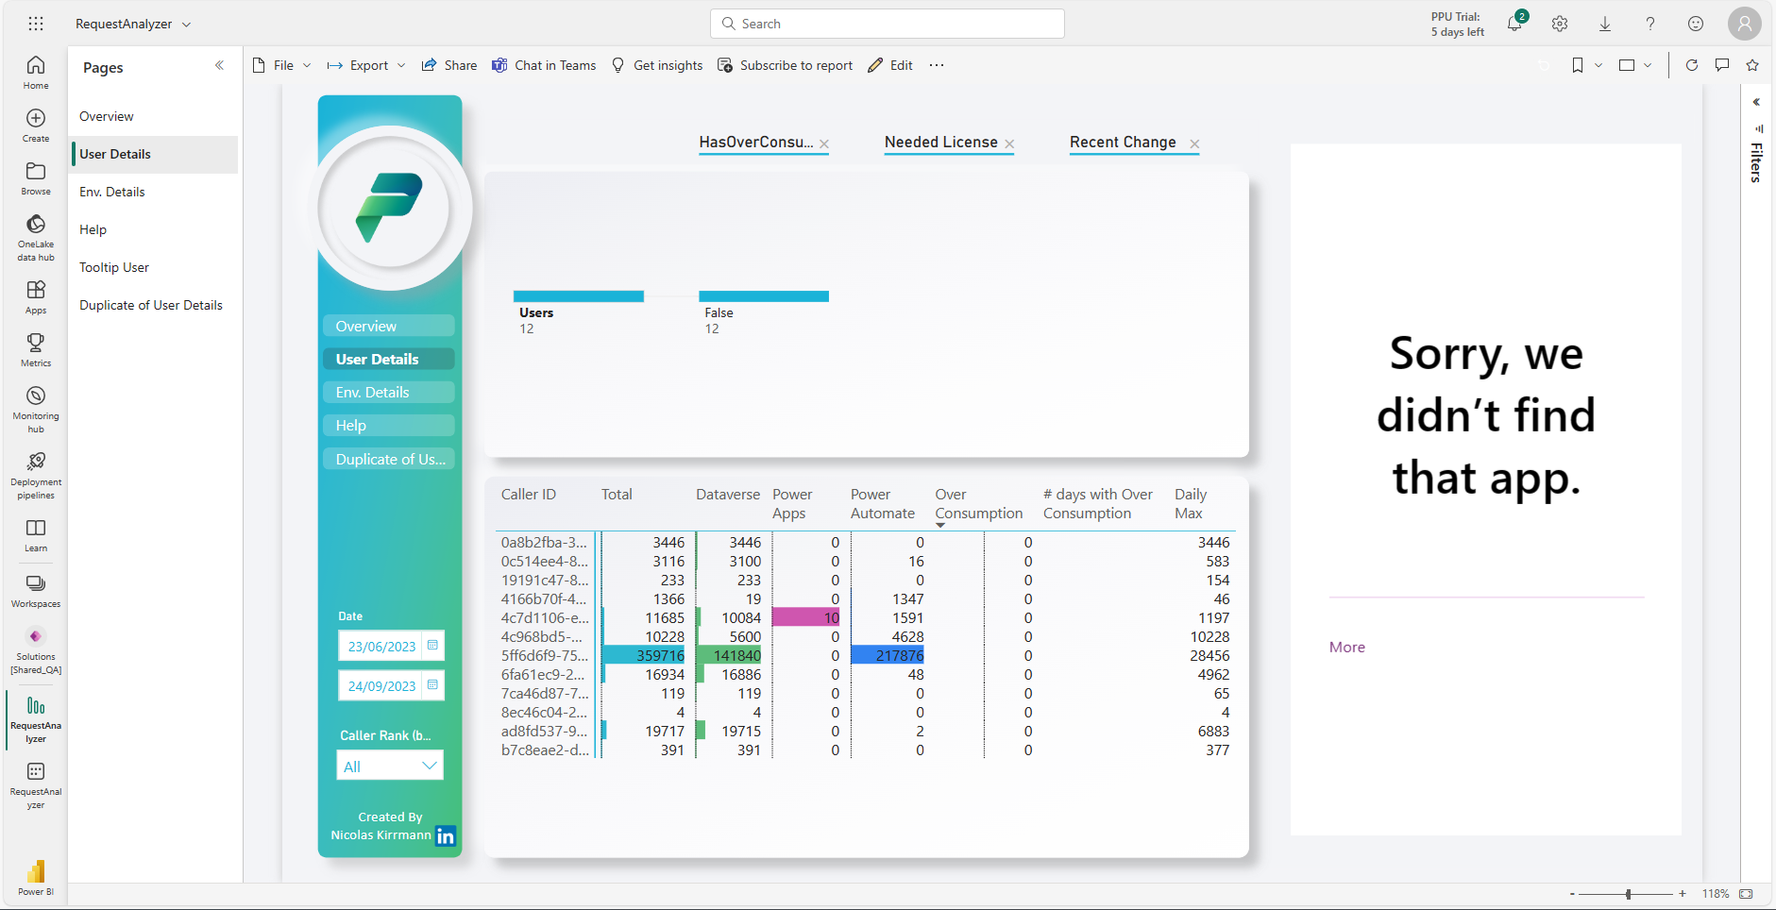
Create connections
Edit the report

Slide 27
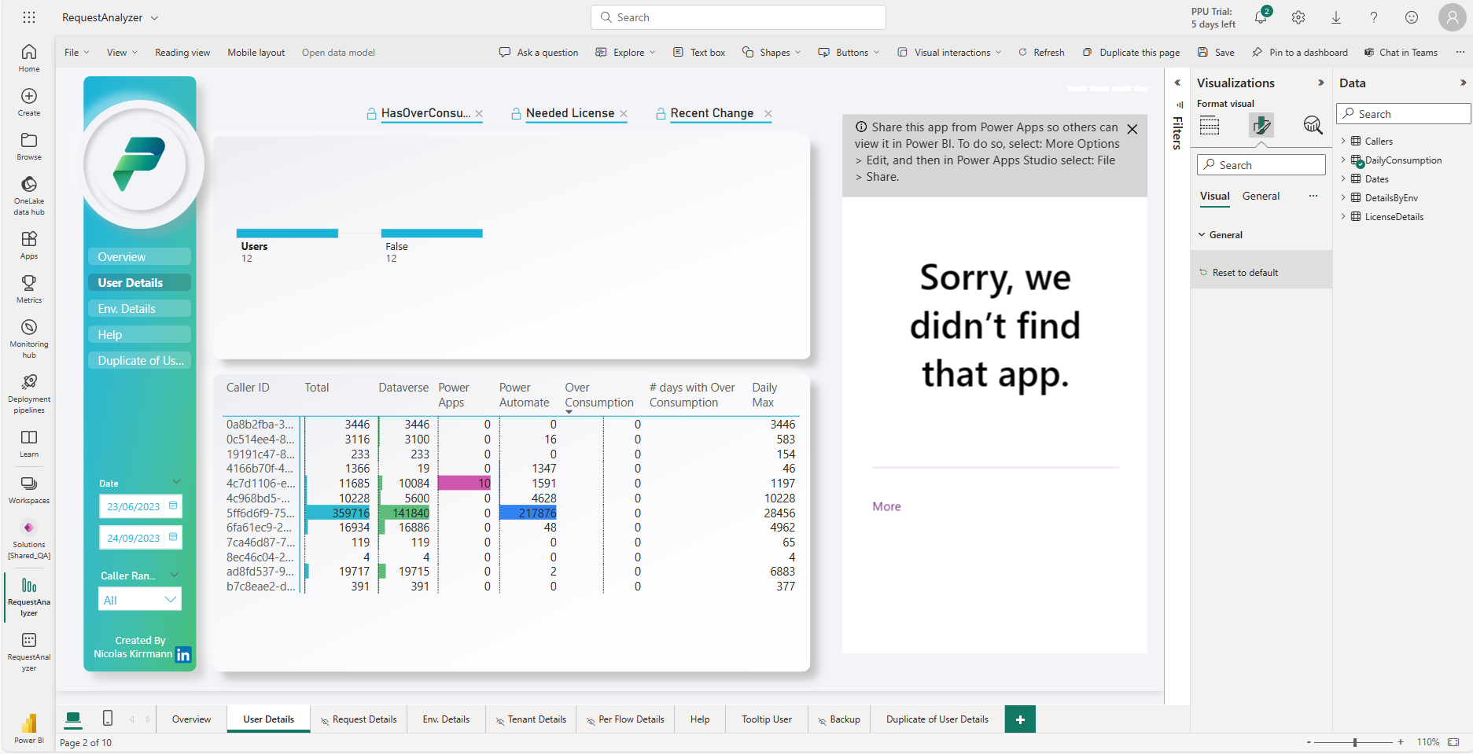
Create connections
1
2
Reset the app component by :
Click on the grey banner to select the PowerApp visual
Select the “Format Visual” tab
Click on “Reset to default”
3

Slide 28
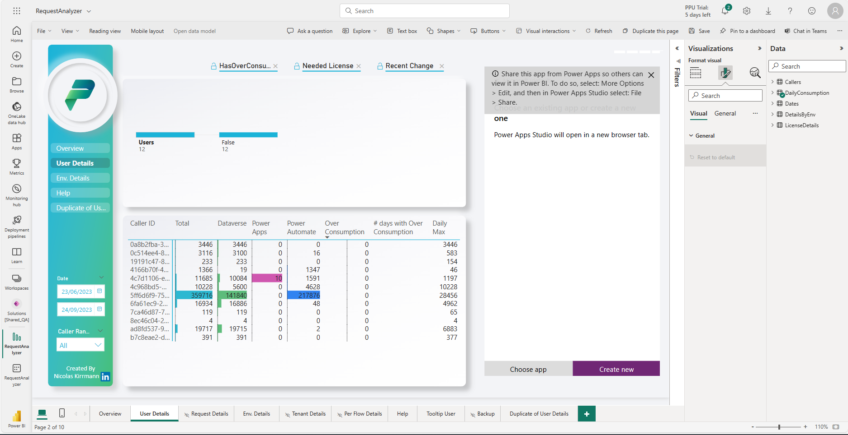
Create connections
Close the banner

Slide 29
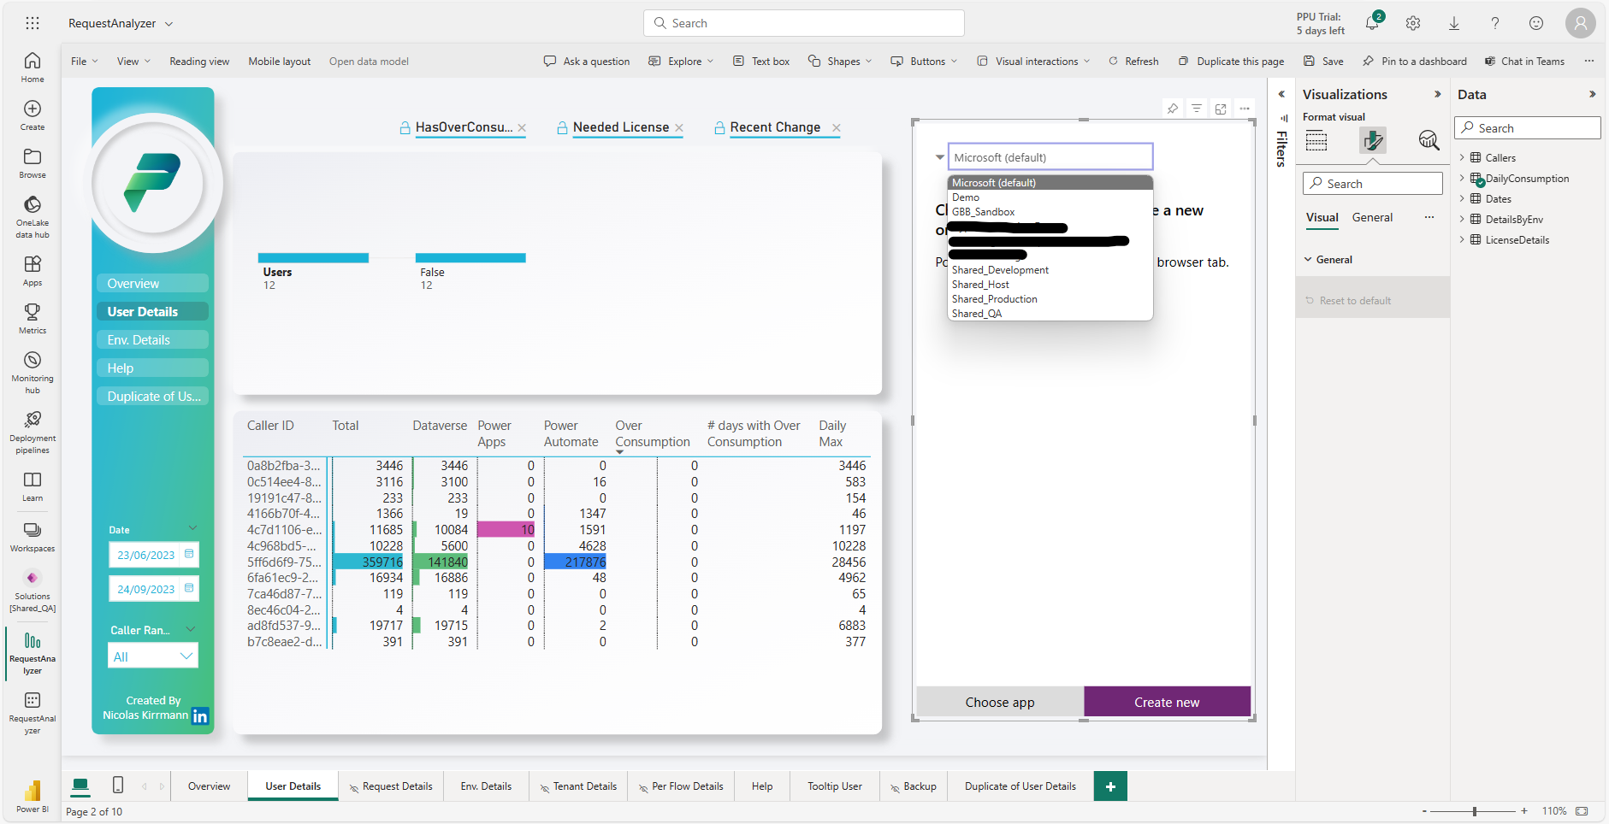
Create connections
1
Select the environment where you deployed the “Request Analyzer” solution
2

Slide 30
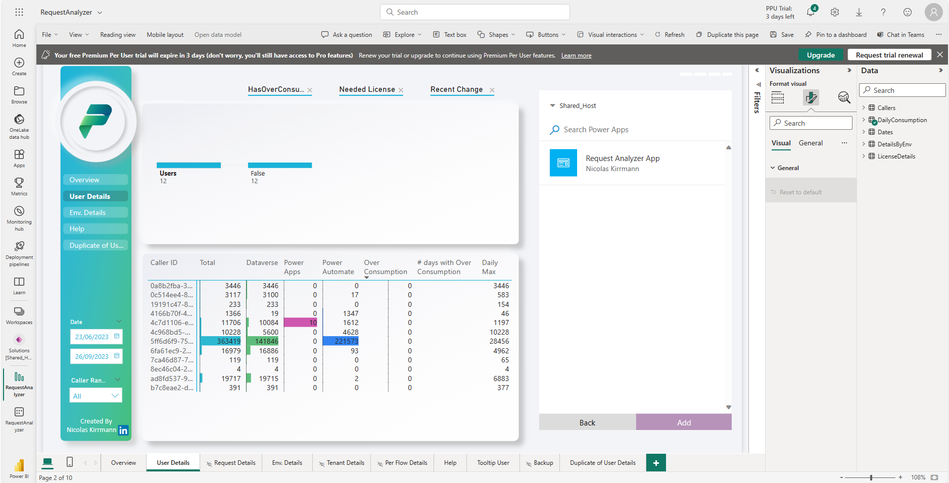
Create connections
1
Select the “Request Analyzer App” and click Add
2

Slide 31
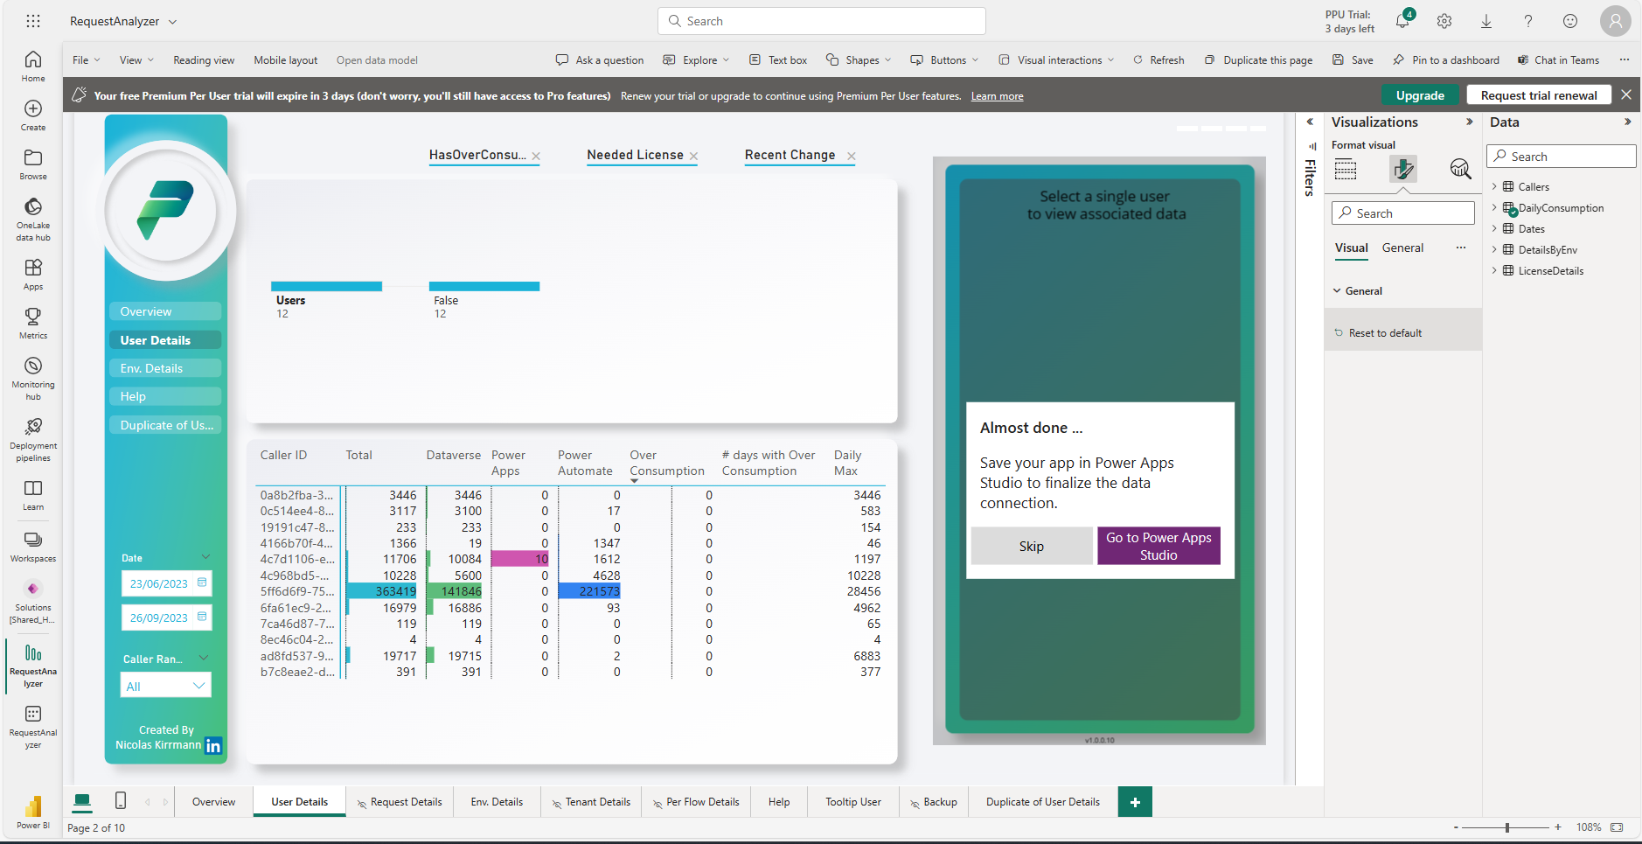
Create connections

Slide 32
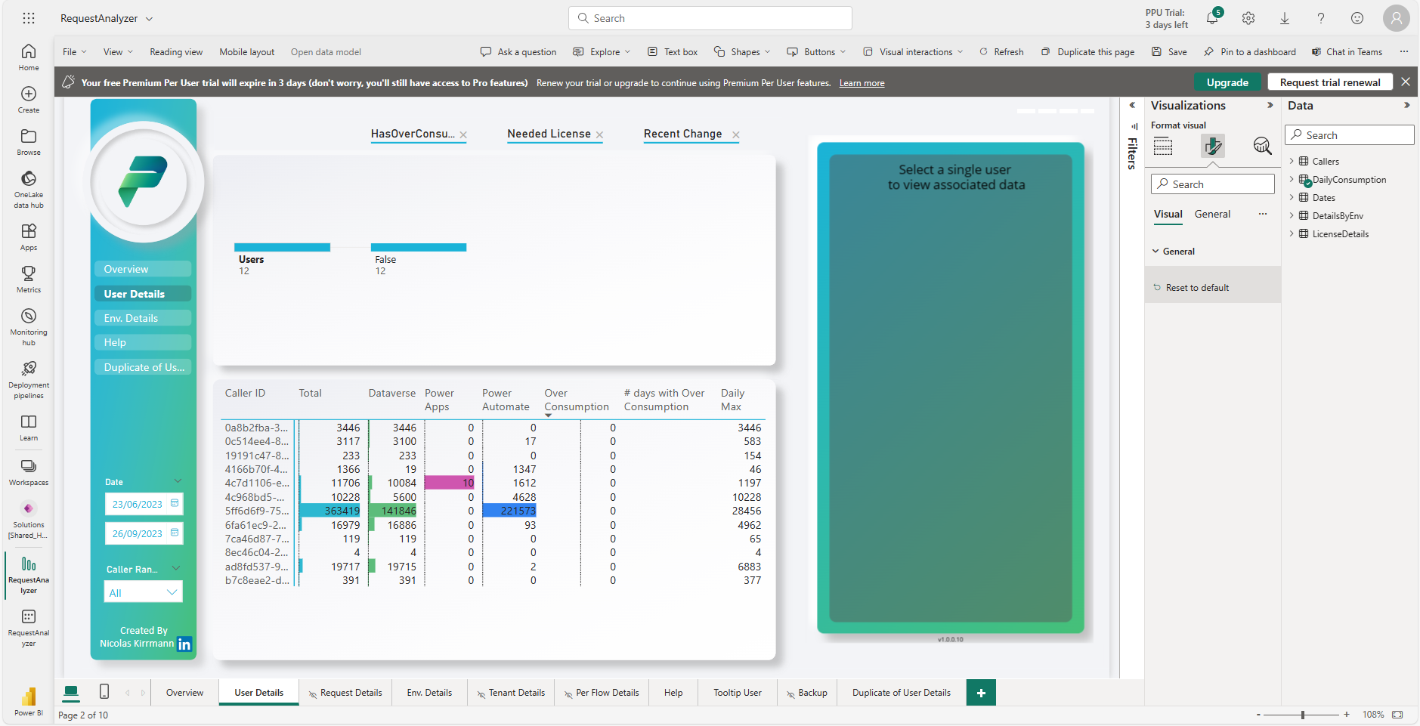
Create connections
Congratulations !
You can now get clear vision & insights on the API consumption

Slide 33
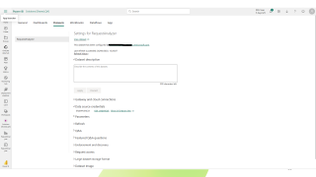
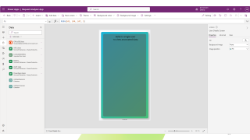


Troubleshooting
The app is not working :
This is likely to be an issue with the app connectivity. Follow these steps to check / rebuild connections
The Power BI is not working :
This is likely to be related to datasource authentication. Follow these steps to verify authentication

Slide 34
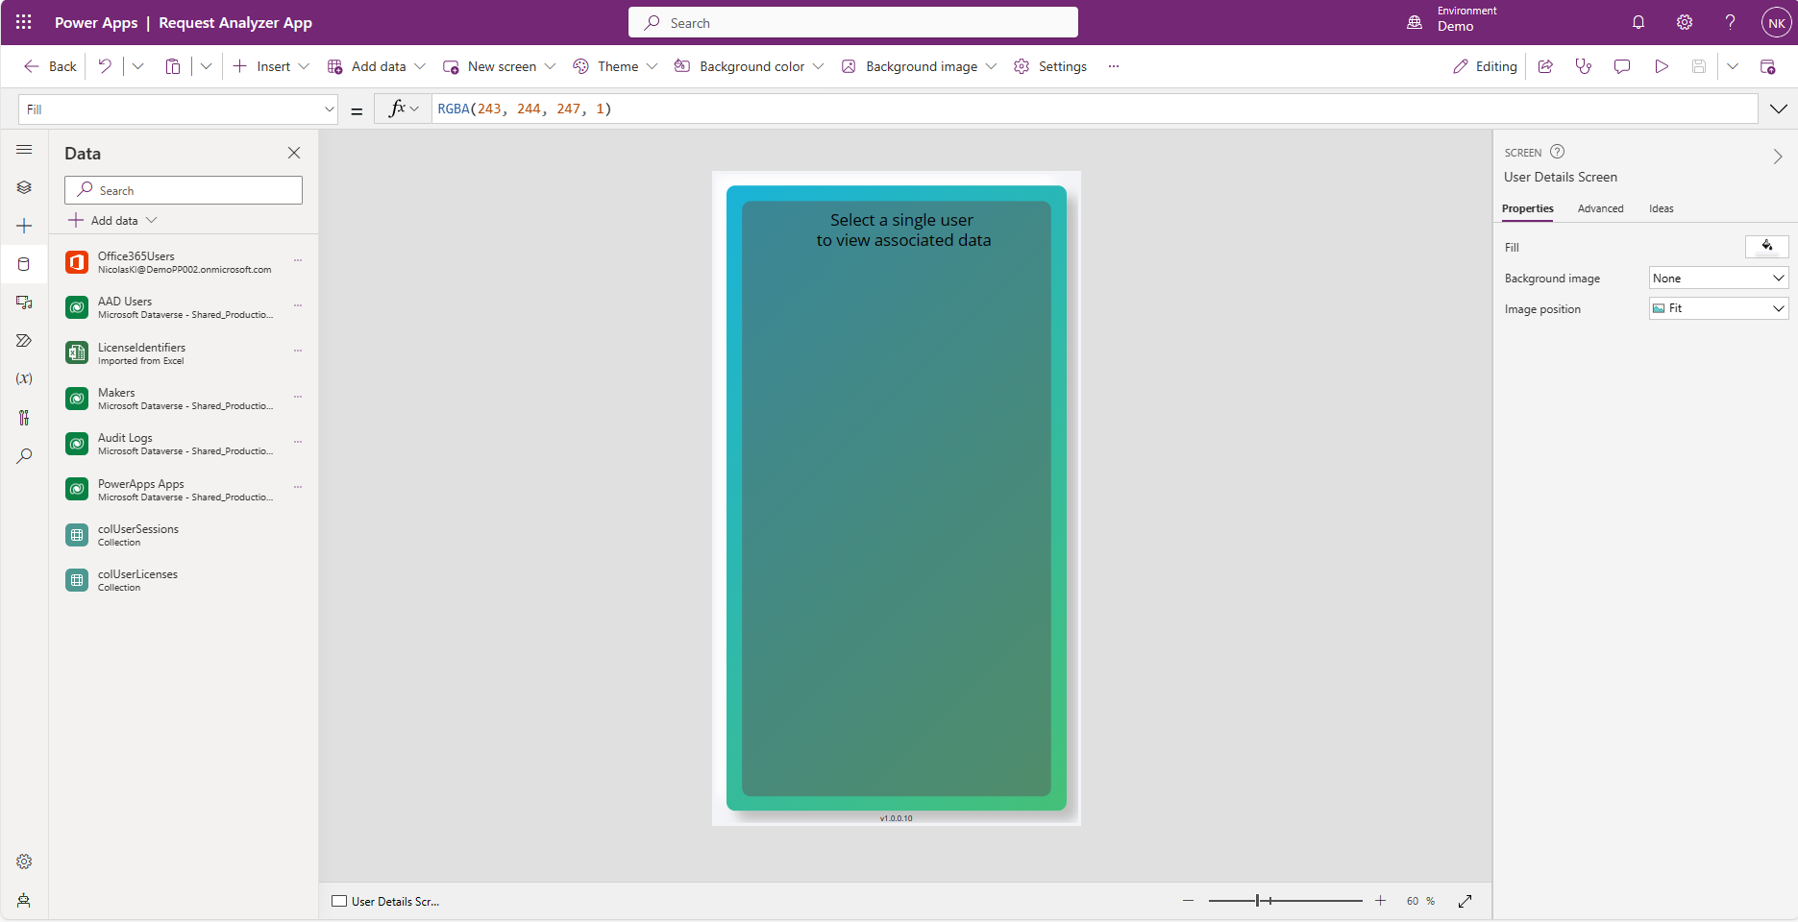
Create connections

Slide 35
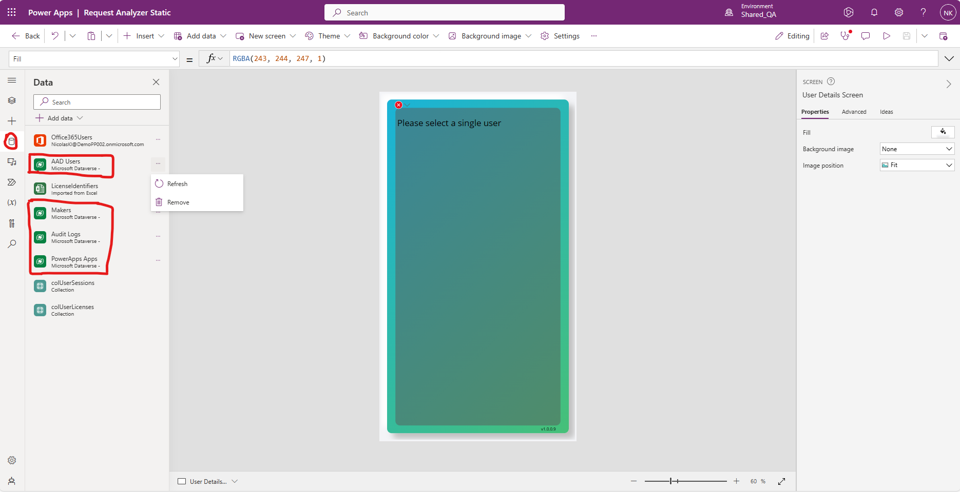
Create connections

Slide 36
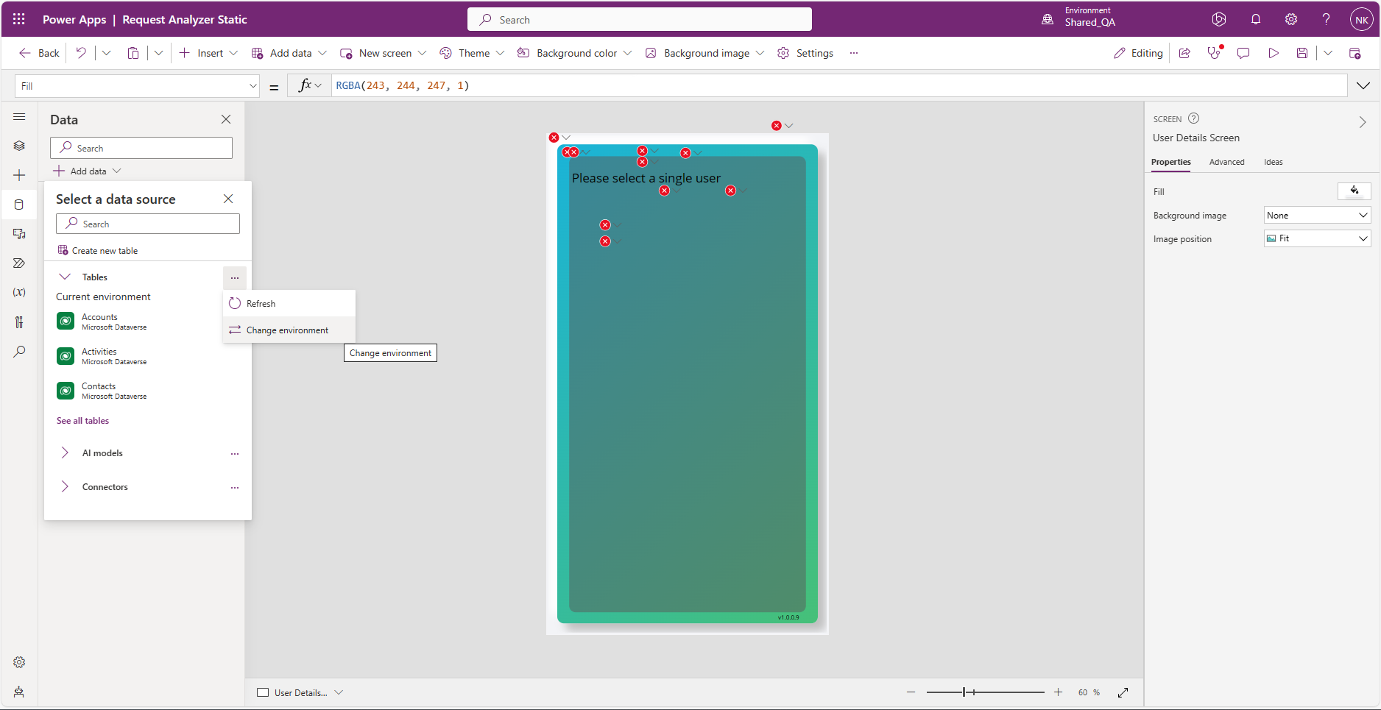
Create connections

Slide 37
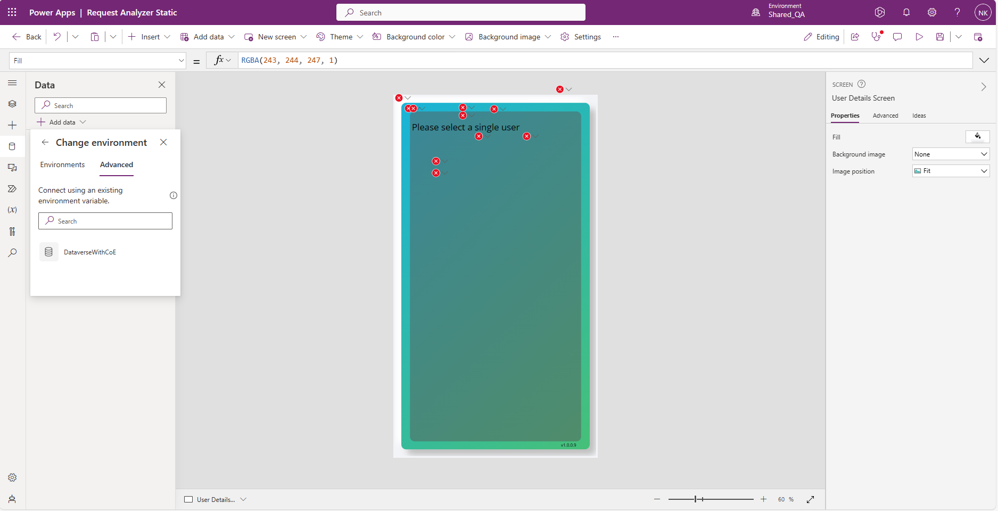
Create connections

Slide 38
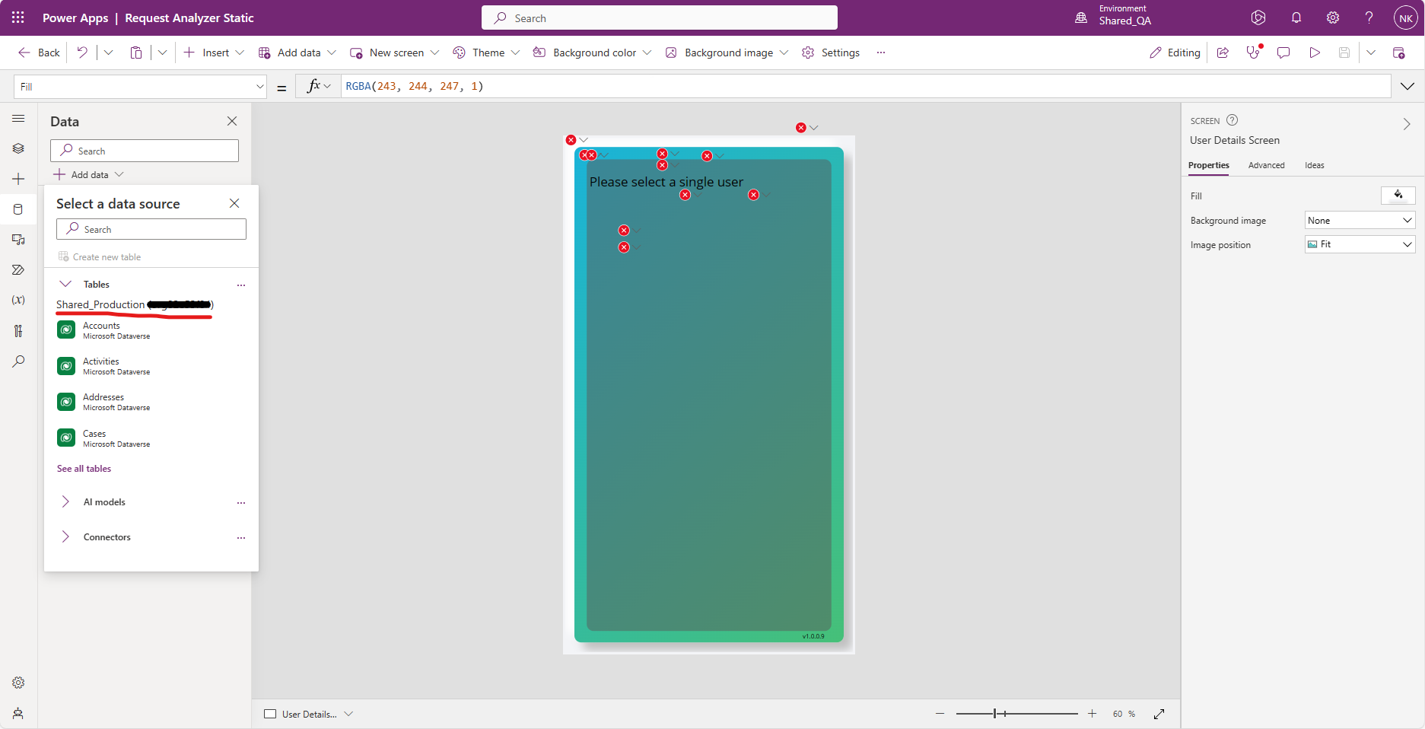
Create connections

Slide 39
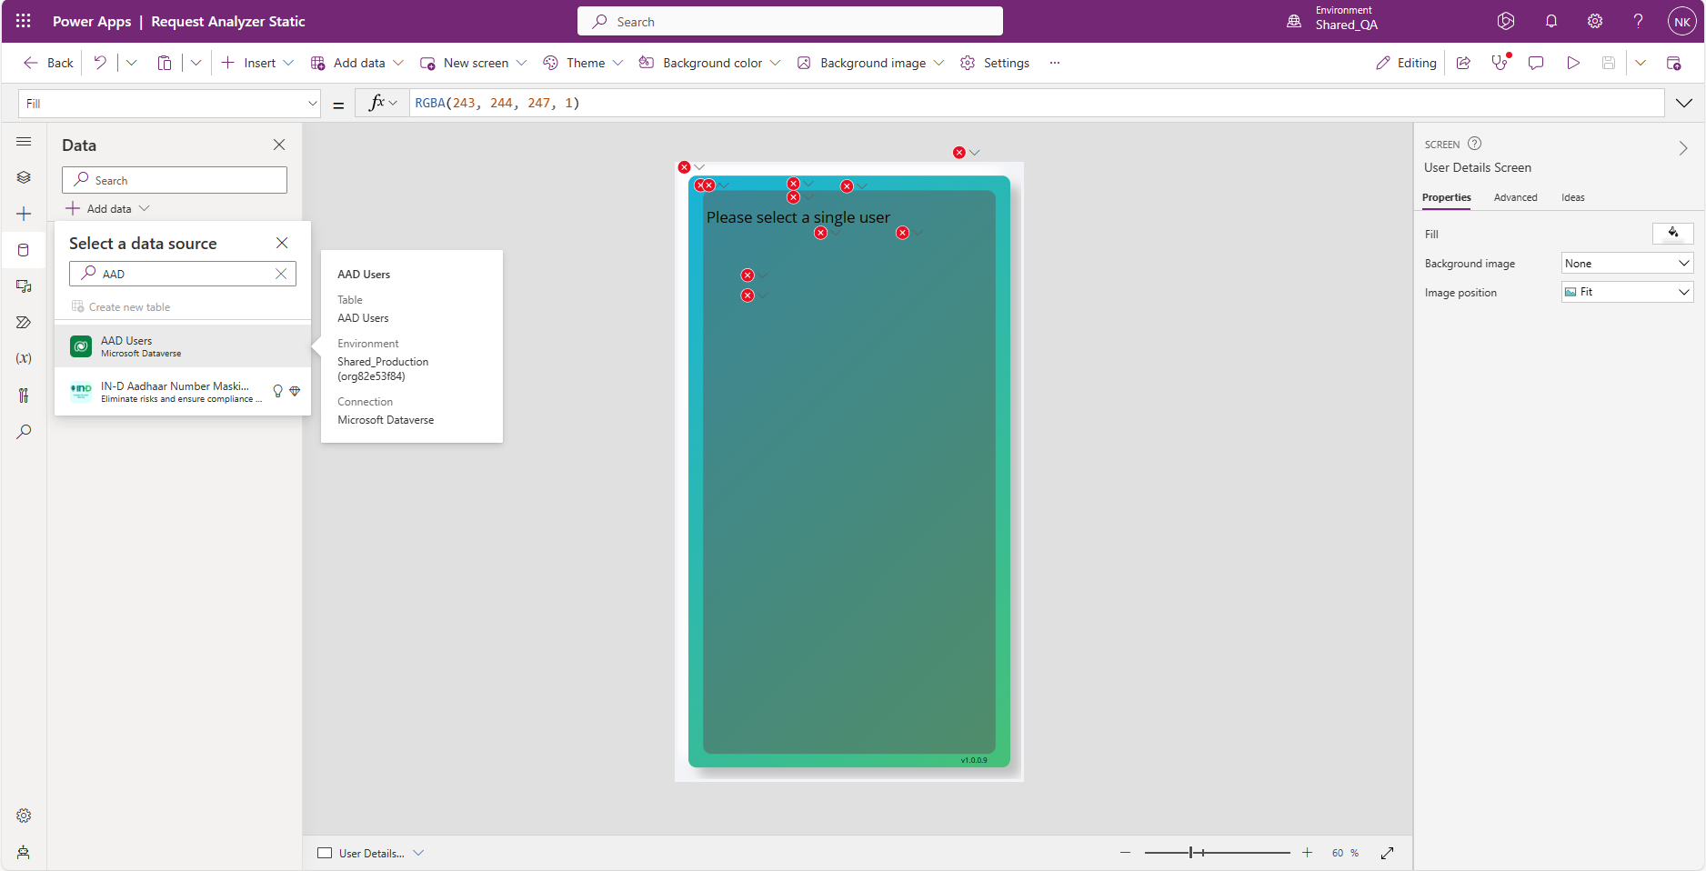
Create connections

Slide 40
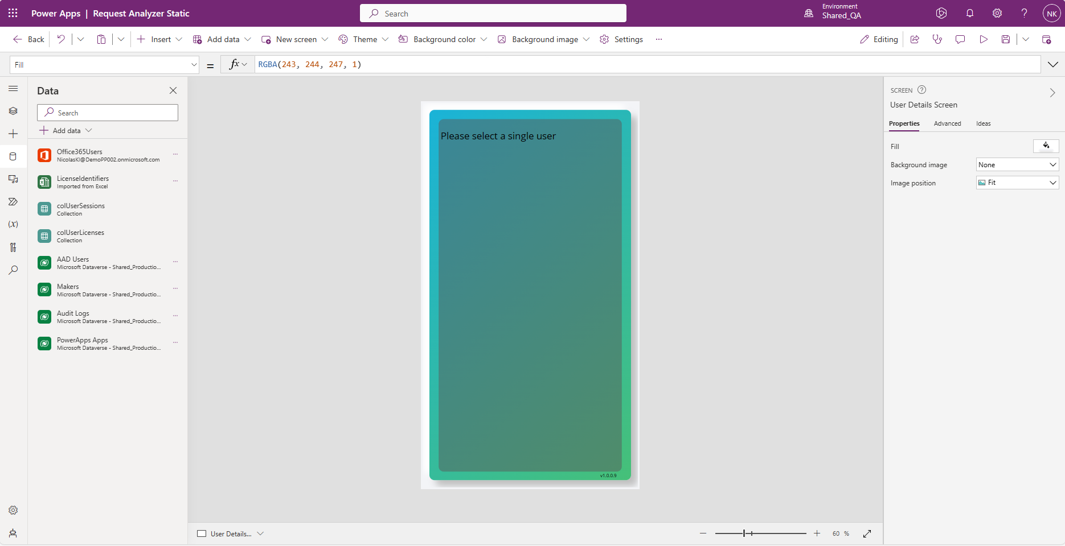
Create connections

Slide 41
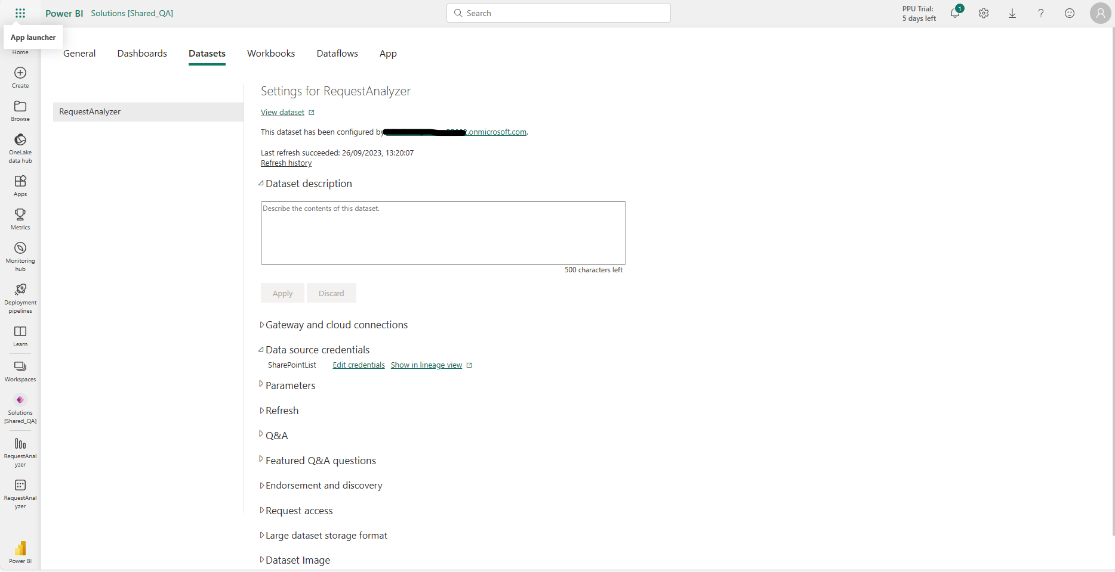
Create connections

Slide 42
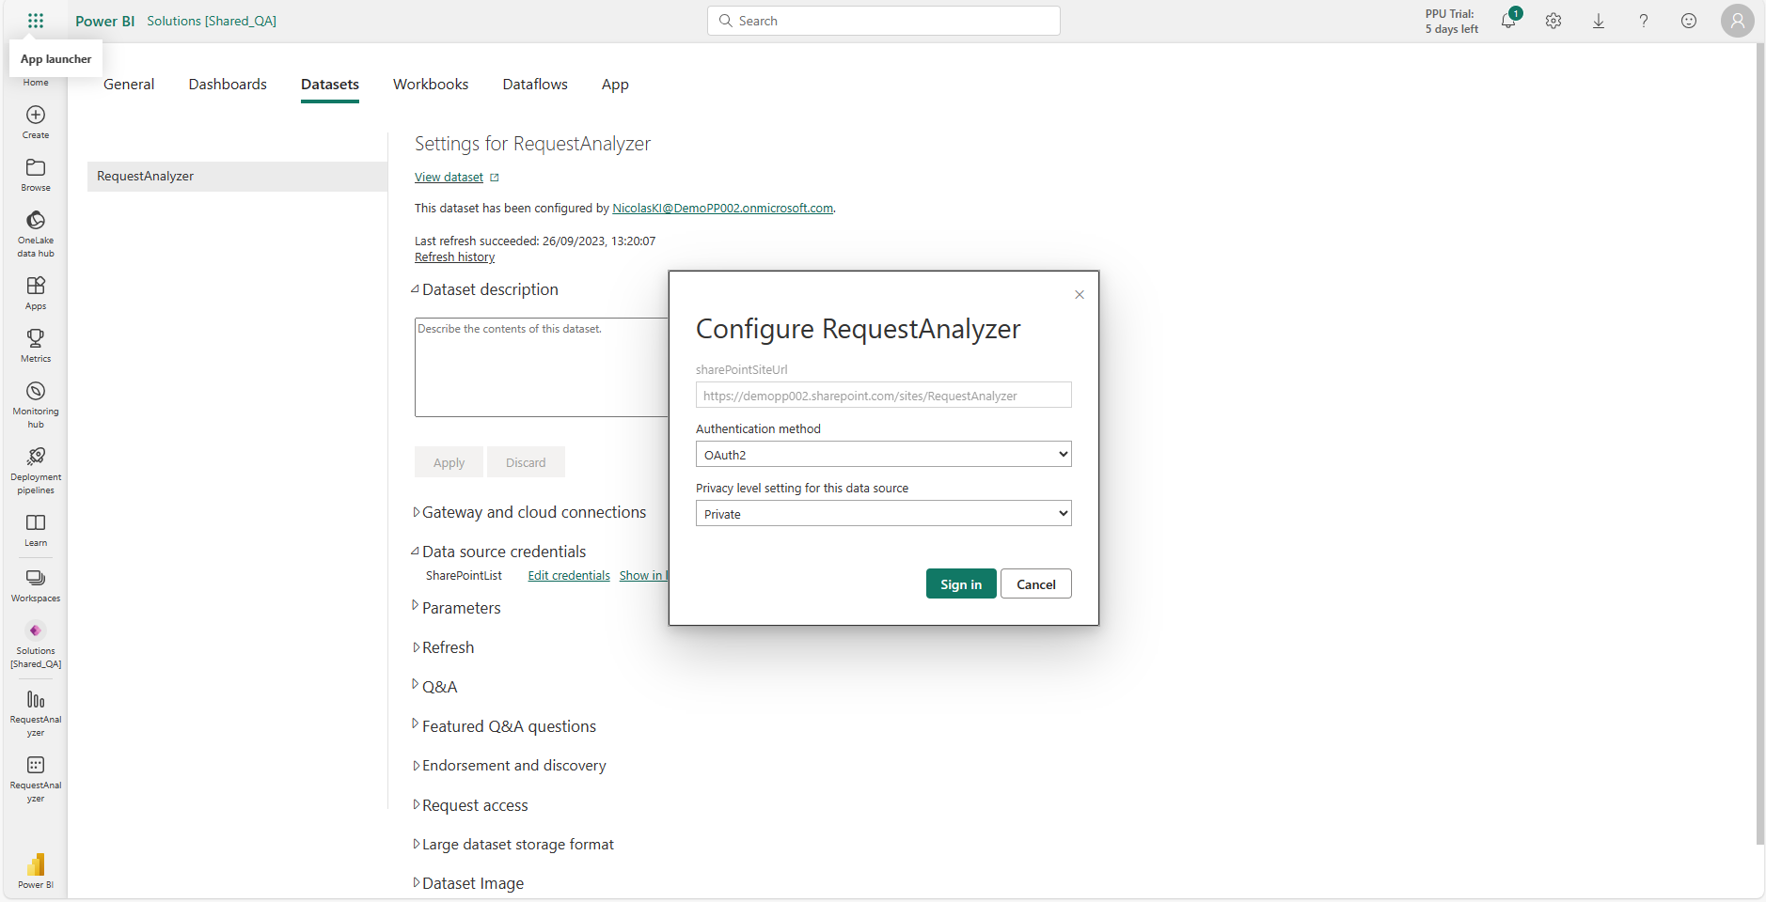
Create connections

